Slide 1
Face Recognition and Liveness Check capabilities
Dileep Gadiraju
Shruti Gupta

Slide 2







Demo App Architecture
Face Profile
Detection Model
Face Matching Model
Secure Websocket two way Communication
Client
Server
Notes:
Presentation Attack Detection system (PAD)
https://pypi.org/project/face_recognition_models/

Slide 3
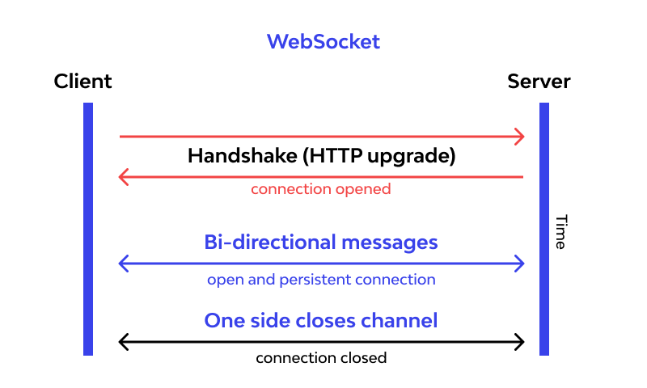
What is Websocket
WebSocket is a communications protocol for a persistent, bi-directional, full duplex TCP connection from a user's web browser to a server.
A WebSocket connection is initiated by sending a WebSocket handshake request from a browser's HTTP connection to a server to upgrade the connection.
Notes:
Presentation Attack Detection system (PAD)

Slide 4
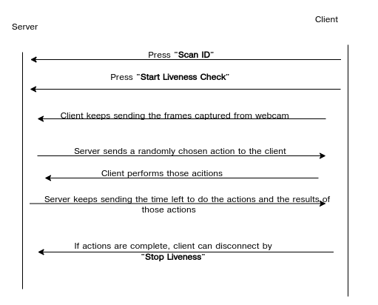
Demo App Communication
Notes:
Presentation Attack Detection system (PAD)
https://pypi.org/project/face_recognition_models/

Slide 5
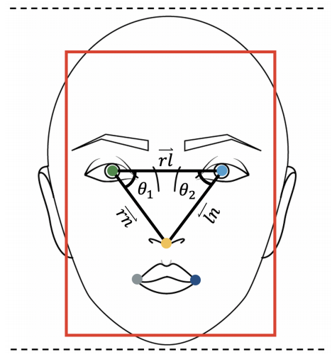
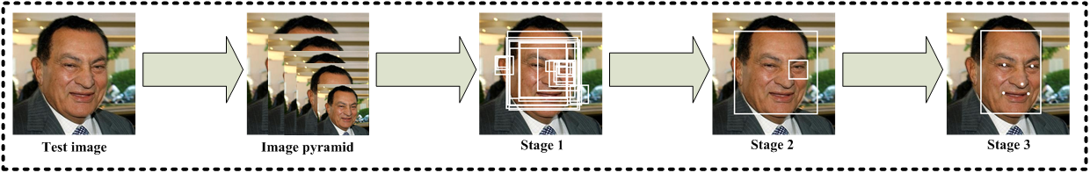
Face Profile Detection Model
Model Used - MTCNN(Multi-Task Cascaded Convolutional Neural Networks)
Accuray on FDDB and WIDER FACE dataset - 95.4 %
WIDER face dataset(32, 203 Images) : http://shuoyang1213.me/WIDERFACE/
FDDB dataset(2,845 Images) : http://vis-www.cs.umass.edu/fddb/index.html
3 stages of MTCNN:
Stage 1 : Face Classification
Stage 2: Bounding box regression
Stage 3 : Facial Landmark Localization
To get profiles(left/right) of faces: Compare angles of obtained landmarks from MTCNN.
Notes:
Capturing Photo identity document
Please make sure application should capture entire image of identity document that has a face picture.
The facial area in the captured photo/image should be minimum of 50x50 pixels of dimension
In case identity document is large please capture photograph in landscape mode.
The allowed image format should be PNG / JPEG / JPEG2000.
Please make sure application only allow using “back” camera of the device or as per use case.
There should not be way to select picture from the phone gallery / storage.
Capturing Video
Please make sure application only allow using “front” camera of the device. Or as per your use case.
There should not be way to select video from phone gallery / storage
The facial area in the captured video should have minimum 200x200 px dimension throughout the video length.
The recording should not exceed 30 FPS.
The maximum video length should not exceed 21 seconds and size should not exceed 5 MB. In case, device has high end camera, please consider downsizing / compression the video.
The allowed upload format is MPEG4 / MP4 / WEBM
When video is getting recorded, application should request user either visually / with audio to carry out facial gesture(s) and note down timestamp range when these actions can be perform. In case you have confusion please look at our demo app or get in touch our development team. This is clearly explained in API document.

Slide 6
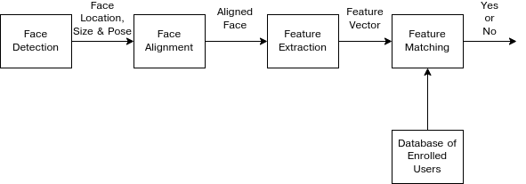
Face Matching Model
Accuracy on LFW(Labeled Faces in the Wild Home) dataset(13,233 Images) http://vis-www.cs.umass.edu/lfw/ -> 99.38 %
Steps for Face Matching:
Face detection -> Using HOG(Histogram of Oriented Gradients) algorithm
Face Alignment -> To centre the image
Feature Extraction -> Pass encodings of the face to pre-trained ResNet model , which gives 128 measurements/landmarks of face
Face Matching -> SVM(Support vector machines) classifier gives the distance between extracted. landmarks of 2 faces.

Slide 7
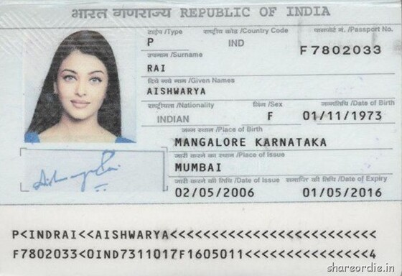
Layout Detection and OCR Capabilities
{
"source": {
"Date of Birth": "01/11/1973",
"Date of Expiry": "01/05/2016",
"Date of Issue": "02/05/2006",
"First Name": "AISHWARYA",
"Gender": "F",
"Nationality": "INDIAN",
"Place of Birth": "MANGALORE KARNATAKA",
"Place of Issue": "MUMBAI",
"Surname": "RAI",
"passport no.": "F7802033"
}
}
Custom Layout Detection
Custom OCR

Slide 8




Face Recognition APIs Architecture
/api/v1/user/login
Python REST APIs
/api/v3/face/verify
/api/v1/ocr/id-card

Slide 9
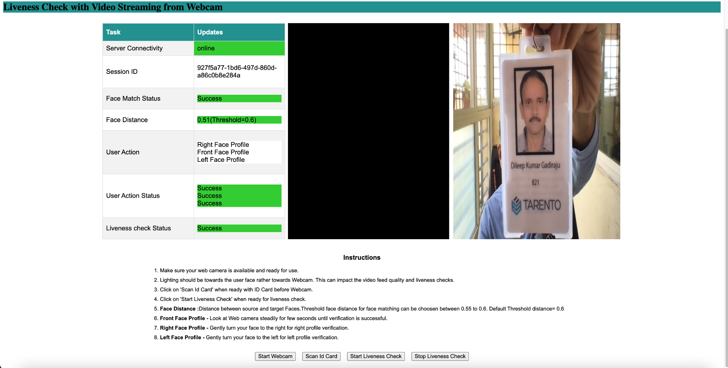
Demo

Slide 10
Q&A

